Slide 1




Exploring a 2D First-Person Game for Blind Players
By: Youssef Youssef
Professor: Yotam Gingold
Date: 03/10/2025

Slide 2
Introduction
Problem: There’s a lack of accessible real-time 2D first person gaming experiences for blind players. There’s only minimal games like cards and such.
Goal: Create a system that converts video to text to narration for an engaging experience (The LLM agent’s answers must be prompted).

Slide 3
Existing Research: (GitHUb and white papers)
Accessible RPG Games:
Text-Based RPGs: "Shadow Line”, "Fantasy Story II”, "The Secret of Darkwoods”, "MUME: Multi-Users in Middle-earth” and "Trawel”
Library for Games that could work for blind people: https://github.com/gamesforblindgamers/blind-accessible-game-engines
Accessibility Features to Look For:
Audio Cues: Games that use distinct audio cues to indicate events, enemy locations, and player actions.
Screen Reader Compatibility: Games that are designed to be played with screen readers, allowing blind players to access text and other information.
Customizable Controls: Games that allow players to customize controls, such as button mapping and sensitivity settings.
Text-Based Gameplay: Games that rely on text-based descriptions and interactions, rather than visual elements.

Slide 4
Overview of Past Work on Video-to-Text Games for Blind Users
The development of video-to-text games for blind users has been an area of active research, aiming to make gaming more accessible to visually impaired individuals. Studies have explored various methods to adapt traditional video games into formats that can be experienced through auditory feedback. For instance, the Audio-based Environment Simulator (AbES) was developed as a virtual reality environment to teach navigation skills to blind users within a video game context. pmc.ncbi.nlm.nih.gov

Slide 5
GitHub Repositories
  Blind-Accessible Game Engines: A curated list of game engines and templates designed specifically for creating games accessible to blind users. github.com
  Accessible Retro Games: Resources for retro video games accessible to blind individuals, utilizing tools like Retroarch and OCR. github.com

Slide 6
Research Papers and White Papers
“"My Zelda Cane": Strategies Used by Blind Players to Play Visual-Centric Digital Games”: The article examines how blind players navigate mainstream games, relying on strategies like memorization, trial-and-error, and audio cues. It analyzes over 70 hours of YouTube videos, highlighting creative strategies and calling for game design improvements to enhance accessibility. dl.acm.org
Limitations:
Relies on YouTube videos, lacking direct input from blind gamers.
Covers only 40 games, missing other genres.
Focuses on English-language content, excluding non-English experiences.
Prioritizes popular videos, potentially missing insights from non-streamers.
Does not include developers' perspectives on accessibility changes.
Game Accessibility for Visually Impaired People: A Review: A comprehensive review discussing the benefits and limitations of game accessibility for visually impaired users. link.springer.com

Slide 7
Key Findings
  Blind players often develop unique strategies to navigate and interact with games not originally designed for accessibility, such as memorizing layouts and relying on auditory cues. dl.acm.org
  The use of spatial audio and haptic feedback can significantly enhance the gaming experience for visually impaired users, making games more immersive and navigable. pmc.ncbi.nlm.nih.gov

Slide 8
Limitations
  Many mainstream games lack built-in accessibility features, requiring external modifications or specialized software to be playable by blind users.
  The development of accessible games often requires additional resources and considerations, which can be a barrier for some developers. link.springer.com

Slide 9
How do 2d first-person games work?
2D first-person games simulate a 3D environment on a 2D plane, using techniques like perspective projection and wall textures to create a sense of depth and immersion, while retaining the simplicity of 2D game development.
Simulating 3D: Instead of a true 3D environment, 2D first-person games use a 2D plane and techniques like perspective projection to make the environment appear three-dimensional.
2D First-Person Perspective: Uses a 2D plane with techniques to create the illusion of depth.
Perspective Projection: Objects appear smaller as they move further from the player, simulating 3D space.
Wall Textures: Stretched and scaled to enhance depth perception.
Raycasting: Determines visible objects by tracing rays from the player's position.
Sectors: Predefined areas optimize rendering and performance.
2D Game Engine: Tools like Tiled help design layouts that can be translated into a 3D-like view.

Slide 10


My Proposed Approach
Using an AI pipeline to process real-time gameplay:
Step 1: Capture screenshots at high frequency (i.e.: every 1 millisecond).
Step 2: Feed the images into an LLM trained (prompted) to generate descriptive game text based on the inputted images. (My suggestion is using groq because it’s currently the fastest AI interface)
Step 3: Convert text into speech using tools like DeepGram Aura.

Slide 11
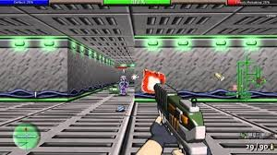

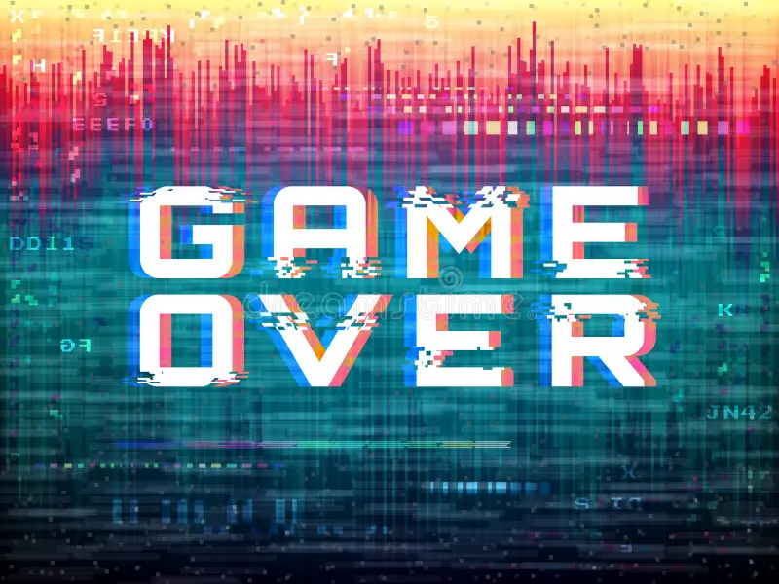



Prototyping the Idea

Slide 12
Tools & Technologies
Sora (OpenAI): Potential for AI-generated environments.
Groq: Fastest AI interface but lower-quality LLM for real-time narration.
DeepGram Aura: Real-time text-to-speech conversion.
Open-source AI models: Customizable solutions for video-to-text.

Slide 13
Challenges & Considerations
Latency in processing and delivering narration.
Quality of descriptions—ensuring they are concise and useful.
User customization: Different players might need different narration speeds or levels of detail.

Slide 14

Conclusion & Next Steps
Summary of Findings:
2D first-person games can effectively simulate a 3D environment using techniques like perspective projection, raycasting, and wall textures.
Video-to-text-to-speech technology can enhance accessibility for blind players by narrating in-game events in real-time.
Existing research and tools provide a foundation, but there are limitations in accuracy, latency, and user experience.
Possible Improvements:
Enhance real-time narration accuracy with advanced AI models.
Optimize performance for smoother gameplay and lower latency.
Improve user customization options for better accessibility.
Future Work:
Conduct user testing with blind players to gather feedback.
Refine AI narration models based on real-world interactions.
Explore additional accessibility features, such as haptic feedback and spatial audio cues.

